Slide 1
Principle of Locality
§5.1 Introduction
Programs
want unlimited amounts of fast memory
Program behavior
access a small proportion of its address space at any time
exhibits spatial and temporal locality
Temporal locality (locality in time)
Spatial locality (locality in space)

Slide 2
Principle of Locality
§5.1 Introduction
Temporal locality
Items accessed recently are likely to be accessed again soon
e.g., instructions in a loop
Spatial locality
Items near those accessed recently are likely to be accessed soon
E.g., sequential instruction access, accessing array data

Slide 3
Memory hierarchy
§5.1 Introduction
Consists of multiple levels of memory with different speeds, sizes & costs
The faster memory is close to the processor and the slower, less expensive memory is below it
Take advantage of principle of locality

Slide 4
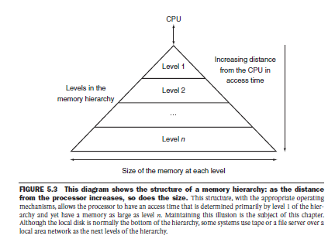
Memory hierarchy
§5.1 Introduction

Slide 5
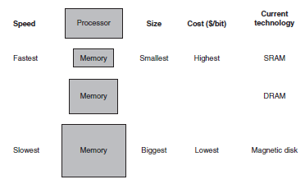
Memory hierarchy
§5.1 Introduction

Slide 6
Technology for memory hierarchy
Static RAM (SRAM)
0.5ns – 2.5ns, $2000 – $5000 per GB
Cache memory
Dynamic RAM (DRAM)
50ns – 70ns, $20 – $75 per GB
Main memory
Magnetic disk
5ms – 20ms, $0.20 – $2 per GB
§5.2 Memory Technologies

Slide 7
Data in memory hierarchy
§5.1 Introduction
The data is hierarchical
Data is copied between only two adjacent levels at a time
Store everything on disk
Copy recently accessed (and nearby) items from disk to smaller Main memory
Copy more recently accessed (and nearby) items from Main memory to Cache memory

Slide 8
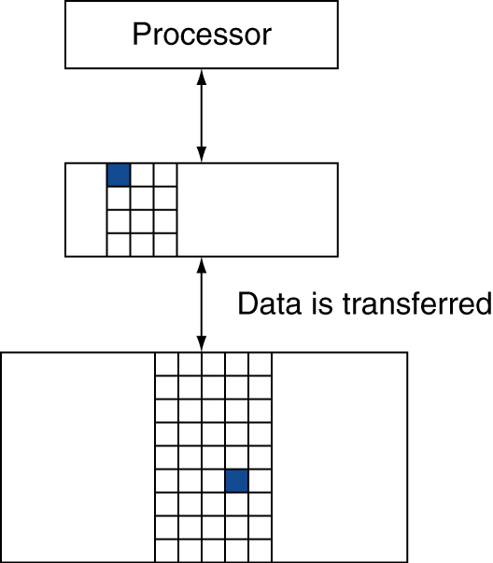
Memory Hierarchy - HIT
§5.1 Introduction
Block (aka line): unit of copying
Consists of multiple words
Hit
If data requested by processor is present in upper level
Hit rate or Hit ratio
Fraction of memory accesses found in the upper level
Hit rate = hits/accesses
Hit time
The time to access the upper level of the memory hierarchy which includes the time needed to determine whether the access is a hit or a miss

Slide 9
Memory Hierarchy - MISS
§5.1 Introduction
Miss
If data requested is absent in upper level
Miss rate or ratio
Fraction of memory accesses not found in the upper level
Miss rate = misses/accesses
Miss rate = 1 – hit ratio
Miss penalty:
The time to replace a block in the upper level with the corresponding block from the lower level, plus the time to deliver this block to the processor

Slide 10
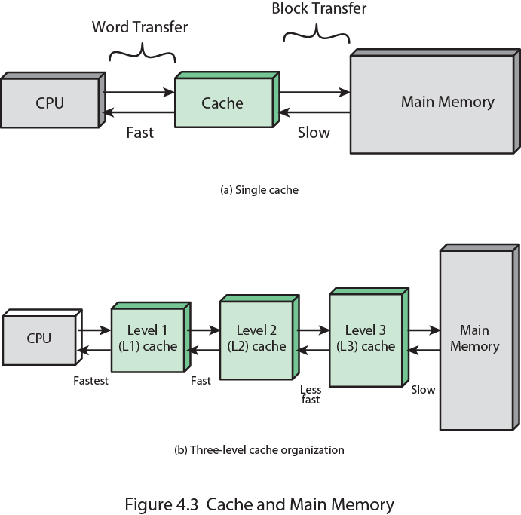
Cache Memory
Small amount of fast memory
Sits between main memory and CPU
May be located on CPU chip

Slide 11
Cache operation – overview
CPU requests contents of memory location
Check cache for this data
If present, get from cache (fast)
If not present, read required block from main memory to cache
Then deliver from cache to CPU
Cache includes tags to identify which block of main memory is in each cache slot

Slide 12
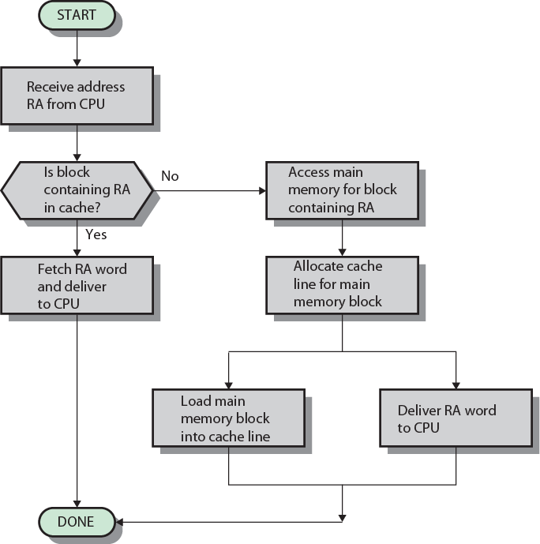
Cache operation - Flowchart
RA – Read address

Slide 13
Average memory access time
Suppose that a processor has a cache and a main memory. The access time of cache is 0.01 ms; The access time of main memory is 0.1 ms.
Suppose 95% of the memory accesses are found in the cache. Find the average memory access time

Slide 14
Average memory access time
Average memory access time
T_{avg} = h*Tc +(1-h)*M
h = hit rate
(1-h) = miss rate
T_{c} = time to access information from cache
M = miss penalty
= (0.95)(0.01 ms) + (0.05)(0.01 ms + 0.1 ms)
= 0.0095 + 0.0055 = 0.015 ms

Slide 15
Main memory
With n-bit address there can be 2^{n} addressable words
Main memory (MM) is considered to consist of a number of fixed length blocks of K words each
Total number of blocks in MM M = 2^{n}/K
§5.3 The Basics of Caches

Slide 16
Cache memory
The cache consists of m blocks, called lines
Size of a cache line = Size of a main memory block
Each line contains
K words
Tag of a few bits
Control bits
Ex. Modified/Not modified
Valid/Invalid
§5.3 The Basics of Caches

Slide 17
Mapping blocks to lines
The number of lines in cache is less than the number of main memory blocks (m <<M)
At any time, some subset of the blocks of memory resides in lines in the cache
Because there are more blocks than lines, an individual line cannot be uniquely and permanently dedicated to a particular block
Each line has a tag
Tag identifies which particular block is currently being stored in a line

Slide 18
Mapping blocks to lines
Because there are fewer cache lines than main memory blocks, an algorithm is needed for mapping main memory blocks into cache lines
Further, a means is needed for determining which main memory block currently occupies a cache line
The choice of the mapping function dictates how the cache is organized
Three techniques can be used: direct, associative, and set associative

Slide 19
Main memory - Example
Main memory address has two fields
s bits specify one of the 2^{s} blocks of main memory
w bits identify a unique word or byte within a block of main memory
block address + word offset
Main memory of 16MB
Address bits : 24 bits
Main memory block of 4 bytes
No. of MM blocks = MM size/block size
No. of MM blocks = 16MB/ 4B = 4MB = 2²²
No. of bits to address 4 MB MM blocks
= log (2²²) = 22 bits
No. of bits to address 4 bytes = log(4) = 2 bits
24 bit address = 22 bit block address and 2 bit word offset

Slide 20
Cache memory - Example
Cache of 64KB
Cache block of 4 bytes
No. of cache lines = Cache size/block size
No. of cache lines = 64KB/ 4B = 16 KB = 2¹⁴
No. of bits to address 14 KB cache lines
= log (2¹⁴) = 14 bits
No. of bits to address 4 bytes = log(4) = 2 bits

Slide 21
Direct Mapped Cache
Simplest technique
Each block of main memory maps into only one possible cache line
The mapping is expressed as
i = j modulo m
i cache line number
j main memory block number
m number of lines in the cache

Slide 22
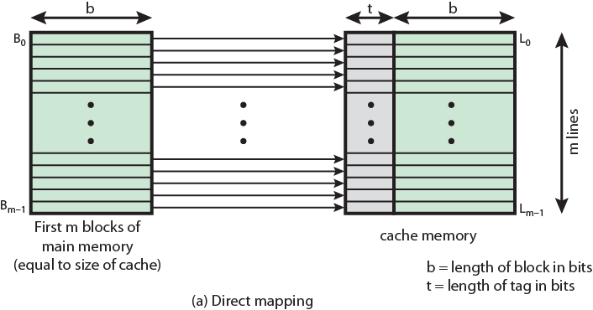
Direct Mapping from Cache to Main Memory

Slide 23
Direct Mapping Cache Line Table
Cache line | Main Memory blocks held
0 | 0, m, 2m, 3m…2s-m
1 | 1,m+1, 2m+1…2s-m+1
…
m-1 | m-1, 2m-1,3m-1…2s-1

Slide 24
Direct Mapping Address
For purposes of cache access, each main memory address can be viewed as consisting of three fields
Line offset
Identifies a unique word or byte within a line of cache memory
The least significant w bits
Line number
Specify one of the m=2r blocks of main memory
The next most significant r bits
Tag
Distinguish a block from other blocks that can fit into a cache line
The most significant portion s – r bits

Slide 25
Direct Mapping Address
Address length = (s + w) bits
Number of addressable units = 2^{s+w} words or bytes
Block size = line size = 2^{w} words or bytes
Number of blocks in main memory = 2^{s+ w}/2^{w} = 2^{s}
Number of lines in cache = m = 2^{r}
Size of tag = (s – r) bits
Size of cache 2^{r+w} words or bytes

Slide 26
Direct Mapping Address Structure
Tag s-r
Line r
Word w
8
14
2
24 bit address
2 bit word identifier (4 byte block)
22 bit block identifier
8 bit tag (=22-14)
14 bit line number
No two blocks in the same line have the same Tag field
Check contents of cache by finding line and checking Tag

Slide 27
Direct-Mapping Cache Organization

Slide 28
Direct-Mapping Cache Working
The cache system is presented with a 24-bit address
The 14-bit line number is used as an index into the cache to access a particular line
If the 8-bit tag number matches the tag number currently stored in that line, then the 2-bit word number is used to select one of the 4 bytes in that line
Otherwise, the 22-bit tag-plus-line field is used to fetch a block from main memory

Slide 29
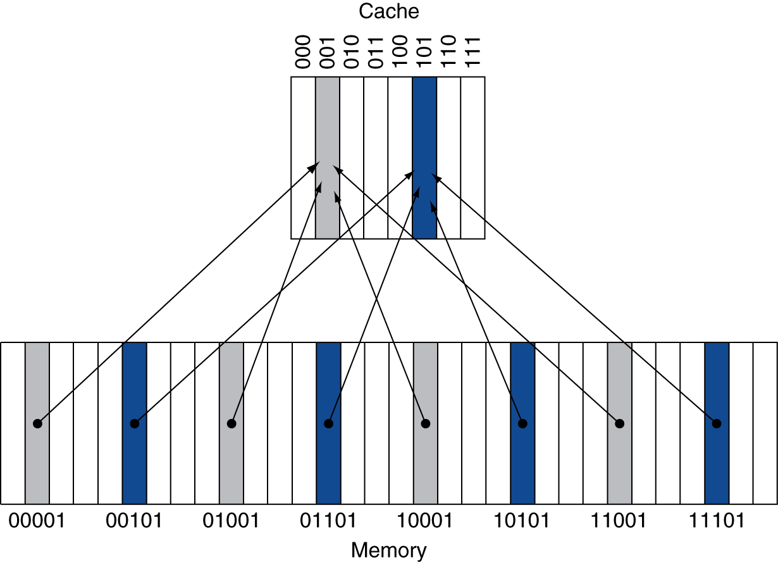
Direct Mapped Cache
Eight words in the cache
32 words in memory
An address X maps to the
direct-mapped cache word
X modulo 8

Slide 30
Tags and Valid Bits
How do we know which particular block is stored in a cache location?
Store block address as well as the data
Actually, only need the high-order bits
Called the tag
What if there is no valid data in a location?
When a processor starts up, the cache does not have good data
Valid bit: 1 = data is valid, 0 = data is invalid
Initially 0

Slide 31
Cache Example (Direct Mapped)
MM Size = 32B, MM addr(bits) = 5,1W = 1B
Block Size = 1B
nBlks in MM = MM Sz /Blk Sz = 32/1 = 32 Blks
Cache Size = 8B, nBlk in C = Cache Sizez/Block Size = 8/1 = 8 Blk
Index (line no) | V | Tag | Data
000 | N
001 | N
010 | N
011 | N
100 | N
101 | N
110 | N
111 | N

Slide 32
Cache Example
MM Blk/Word addr (5bits) | Binary addr | Hit/miss | Cache block = (mm blk add % nBlk in C)
22 | 10 110 | Miss | (22%8=6) 110
Index (line no) | V | Tag | Data (1Bllk = 1 W = 1 Byte)
000 | N
001 | N
010 | N
011 | N
100 | N
101 | N
110 | Y | 10 | Mem[10110]
111 | N

Slide 33
Cache Example
Word addr | Binary addr | Hit/miss | Cache block
26 | 11 010 | Miss | (26 mod 8 = 2) 010
Index | V | Tag | Data
000 | N
001 | N
010 | Y | 11 | Mem[11010]
011 | N
100 | N
101 | N
110 | Y | 10 | Mem[10110]
111 | N

Slide 34
Cache Example
Word addr | Binary addr | Hit/miss | Cache block
22 | 10 110 | Hit | (22 mod 8 = ) 110
26 | 11 010 | Hit | (26 mod 8 = 2) 010
Index | V | Tag | Data
000 | N
001 | N
010 | Y | 11 | Mem[11010]
011 | N
100 | N
101 | N
110 | Y | 10 | Mem[10110]
111 | N

Slide 35
Cache Example
Word addr | Binary addr | Hit/miss | Cache block
16 | 10 000 | Miss | (6 mod 8 = 0) 000
3 | 00 011 | Miss | (3 mod 8 = 3) 011
16 | 10 000 | Hit | (16 mod 8 = 0) 000
Index | V | Tag | Data
000 | Y | 10 | Mem[10000]
001 | N
010 | Y | 11 | Mem[11010]
011 | Y | 00 | Mem[00011]
100 | N
101 | N
110 | Y | 10 | Mem[10110]
111 | N

Slide 36
Cache Example
Word addr | Binary addr | Hit/miss | Cache block
18 | 10 010 | Miss | (18 mod 8 = 2) 010
Index | V | Tag | Data
000 | Y | 10 | Mem[10000]
001 | N
010 | Y | 10 | Mem[10010]
011 | Y | 00 | Mem[00011]
100 | N
101 | N
110 | Y | 10 | Mem[10110]
111 | N

Slide 37
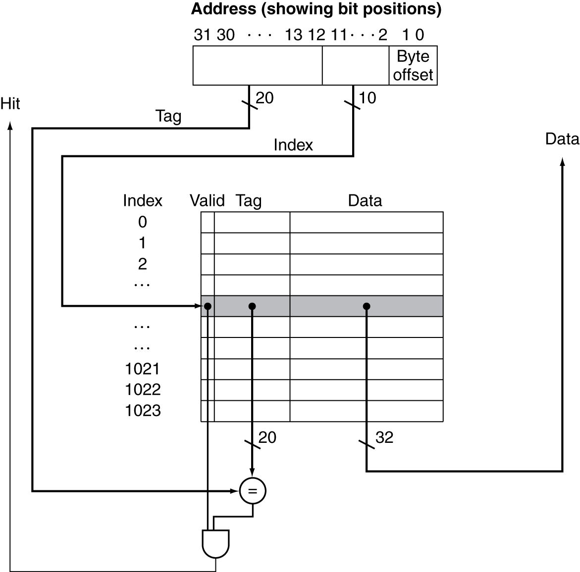
Address Subdivision

Slide 38
Address Subdivision - Example
Main Memory Size = 4GB
Main Memory address = 32 bits
Block Size = 1 word
1 Word = 4 Bytes => nbits for Byte offset = 2
Cache Memory Size = 4KB
No. of Cache Blocks = Cache Memory Size / Block Size (in Bytes)
= 4KB /4
= 1024 Blocks => 10 bits for line no
So no. of bits for Tag
= Main Memory address – (bits for Cache Block + bits for byte offset)
= 32 – (20 + 2) = 20

Slide 39
The total number of bits in a direct-mapped cache is
2^{n} ⋅ (block size + tag size + valid field size).

Slide 40
Bits in a Cache
How many total bits are required for a direct-mapped cache with 16 KB of data and 4-word blocks, assuming a 32-bit address?
Each block has 4 * 32 or 128 bits of data plus a tag, which is 32 –( 10 + 2 + 2) bits, plus a valid bit
Thus, the total cache size is
2¹⁰ *(4 * 32 + (32 - 10 - 2 - 2) + 1) = 2¹⁰ * 147 bits = 18.4 KB

Slide 41

Mapping an Address to a Multiword Cache Block
The address of the block is

Slide 42
Mapping an Address to a Multiword Cache Block
Assume 32 bit address
Cache with 64 blocks and a block size of 16 bytes
To what block number does address 1200 map?
Block address = ⎣1200/16⎦ = 75
Block number = 75 modulo 64 = 11
31
10
9
4
3
0
Tag
Index
Offset
22 bits
6 bits
4 bits

Slide 43
Block Size Considerations
Larger blocks should reduce miss rate
Due to spatial locality
But in a fixed-sized cache
Larger blocks ⇒ fewer of them in cache
More competition ⇒ increased miss rate
Larger blocks means large miss penalty as transfer time increases

Slide 44
Cache Misses
On cache hit, CPU proceeds normally
On cache miss
Stall the CPU pipeline
Fetch block from next level of hierarchy
Instruction cache miss or Data cache miss

Slide 45
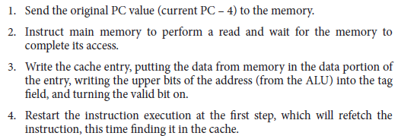
Instruction cache miss

Slide 46
Data cache miss
Stall pipeline
Send the address of data to memory
Instruct main memory to perform a read and wait for the memory to complete its data access
Write the cache entry, putting the data from memory in the data portion of the entry, writing the upper bits of the address (from the ALU) into the tag field, and turning the valid bit on
Restart execution of instruction

Slide 47
Write-Through
On data-write hit, could just update the block in cache
But then cache and memory would be inconsistent
Write through: also update memory
But makes writes take longer
Solution: write buffer
Holds data waiting to be written to memory
CPU continues immediately
Only stalls on write if write buffer is already full

Slide 48
Write-Back
Alternative: On data-write hit, just update the block in cache
Keep track of whether each block is dirty
When a dirty block is replaced
Write it back to memory

Slide 49
Associative Caches
Fully associative
Allow a given block to go in any cache entry
Requires all entries to be searched at once
Comparator per entry (expensive)
n-way set associative
Each set contains n entries
Block number determines which set
(Block number) modulo (#Sets in cache)
Search all entries in a given set at once
n comparators (less expensive)

Slide 50
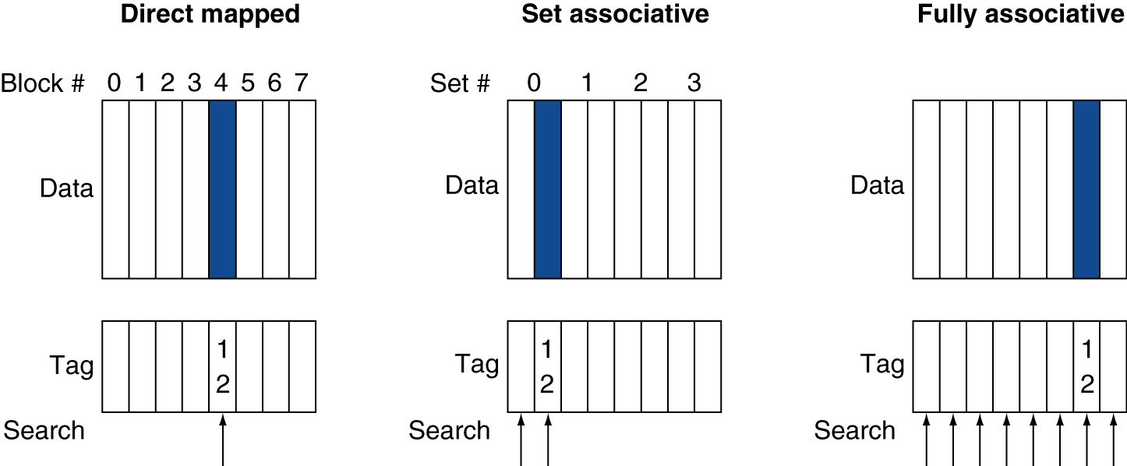
Associative Cache Example

Slide 51
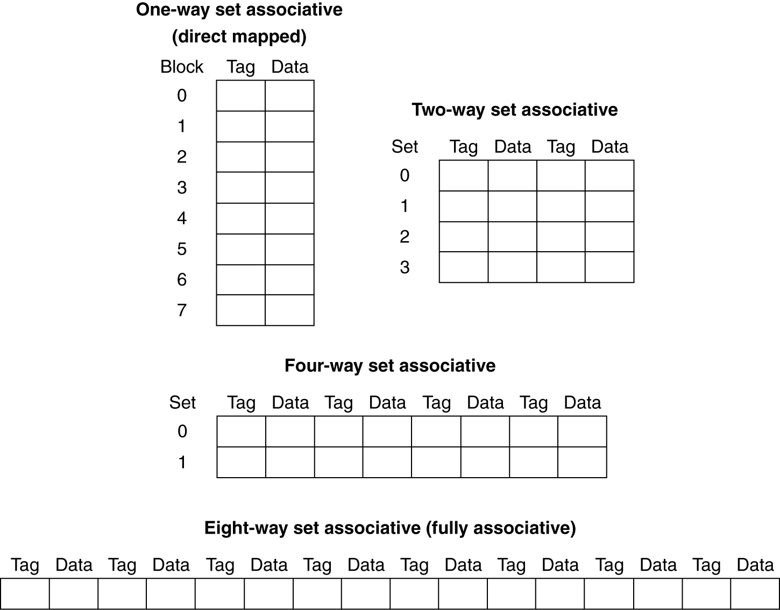
Spectrum of Associativity
For a cache with 8 entries

Slide 52
Associativity Example
Compare 4-block caches
Direct mapped, 2-way set associative, fully associative
Block access sequence: 0, 8, 0, 6, 8
Direct mapped
Block address | Cache index | Hit/miss | Cache content after access
 |  |  | 0 | 1 | 2 | 3
0 | 0 | miss | Mem[0]
8 | 0 | miss | Mem[8]
0 | 0 | miss | Mem[0]
6 | 2 | miss | Mem[0] |  | Mem[6]
8 | 0 | miss | Mem[8] |  | Mem[6]

Slide 53
Associativity Example
2-way set associative
Block address | Cache index | Hit/miss | Cache content after access
 |  |  | Set 0 |  | Set 1
0 | 0 | miss | Mem[0]
8 | 0 | miss | Mem[0] | Mem[8]
0 | 0 | hit | Mem[0] | Mem[8]
6 | 0 | miss | Mem[0] | Mem[6]
8 | 0 | miss | Mem[8] | Mem[6]
Fully associative
Block address |  | Hit/miss | Cache content after access
0 |  | miss | Mem[0]
8 |  | miss | Mem[0] | Mem[8]
0 |  | hit | Mem[0] | Mem[8]
6 |  | miss | Mem[0] | Mem[8] | Mem[6]
8 |  | hit | Mem[0] | Mem[8] | Mem[6]

Slide 54
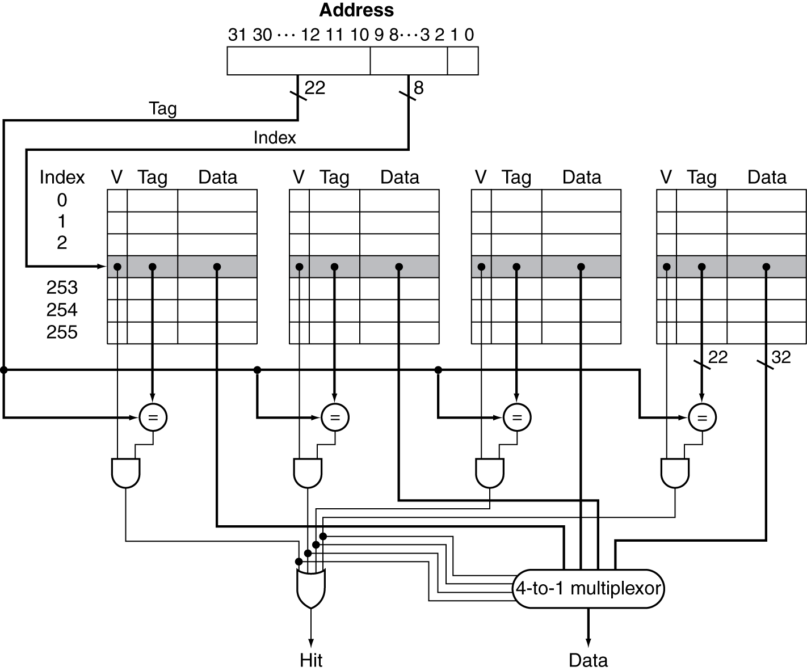
Set Associative Cache Organization

Slide 55
Replacement Policy
Direct mapped: no choice
Set associative
Prefer non-valid entry, if there is one
Otherwise, choose among entries in the set
Least-recently used (LRU)
Choose the one unused for the longest time
Simple for 2-way, manageable for 4-way, too hard beyond that
Random
Gives approximately the same performance as LRU for high associativity

